Slide 1

Fun time
July 2023

Slide 2
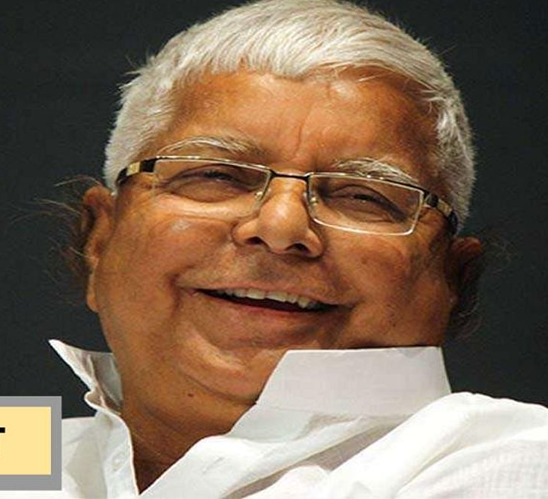
Guess who?

Slide 3


Guess the place !
Tea Garden

Slide 4

Who can help us to find truffles?
Squirrels
Parrot
Pigs
Beer

Slide 5

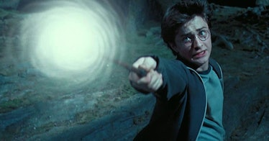
Guess Harry's spell
Alohomora

Slide 6

What never asks a question but gets answered all the time?
Cellphone

Slide 7
What starts with “e” and ends with “e” but only has one letter in it?
An envelope

Slide 8
If Mrs. John’s one-story house is decorated completely in pink,
with the walls, carpet, and furniture all shades of pink,
what color are the stairs?
There are no stairs

Slide 9

Guess who?

Slide 10
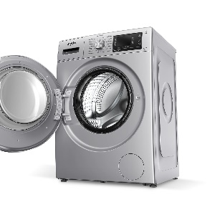

Guess it!!!!!
Washington

Slide 11


Position in cosmos that supports life
ZONE
Goldilocks Zone

Slide 12
What has a face and two hands, but no arms or legs?
A clock

Slide 13
What goes up but never ever comes down?
Our age

Slide 14
If you have one, you want to share it. But once you share it, you do not have it. What is it?
A secret

Slide 15


Guess it !!!!
Pentagon

Slide 16
Who invented magnifying glass?
Issac Newton
Roger Bacon
Gherardo di Gherardo
Benjamin Franklin
Roger Bacon, 1250

Slide 17


Guess the movie!
Ratatouille

Slide 18
Which two keys can’t open any door?
A monkey and a donkey

Slide 19
Who is bigger, Mr. Bigger, Mrs. Bigger, or their baby?
The baby, since he is a little Bigger.

Slide 20
I start out tall, but the longer I stand, shorter I grow. What am I ?
A candle

Slide 21
How can the pocket of your pants be empty, but still have something in it?
When the something is a hole.

Slide 22
Thank you!!!

